Slide 1


Data Analysis
Cleaning, Transforming, Modeling, Draw conclusions,
Decision-making, Finding patterns

Slide 2





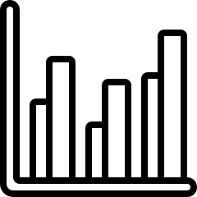
Contents
Introduction
Demo / Use Case
Data Manipulation Libraries
Conclusion
Data Visualization

Slide 3






Why Python is Popular for Data Analysis
Key Reasons for Python's Dominance in Data Analysis
Integration with Big Data: Apache Spark, handling large-scale datasets
Versatility: Web dev, ML AI and many more
Ease of Learning and Readability
Open Source and Free: Free to use, distribute, and modify
Extensive Libraries: Numpy, Pandas, Matplotlib, Seaborn

Slide 4
Why Python is Popular for Data Analysis
Key Reasons for Python's Dominance in Data Analysis
Scientific Computing
Ecosystem: SciPy,
optimization, signal
processing, linear
algebra
Machine Learning and
AI: Scikit-learn,
TensorFlow, PyTorch
Cross-Platform
Compatibility: Python
(Windows, macOS,
Linux)

Slide 5
Data Manipulation and Visualization Libraries
Numpy: Array creation and manipulation, Mathematical Operations
Pandas: Series and DataFrame, Data cleaning and preprocessing, Data indexing and selection
Matplotlib: Plotting basic graphs (line, bar, scatter)
Seaborn: Statistical data visualization, Pair plots, heatmaps, Customizing plots

Slide 6
Conclusion
Data analysis involves extracting valuable insights from datasets to inform decision-making. It encompasses techniques for cleaning, processing, and interpreting data, often utilizing statistical methods and visualization tools. The ultimate goal is to uncover patterns, trends, and meaningful information that can drive informed actions and strategies.

